Slide 1
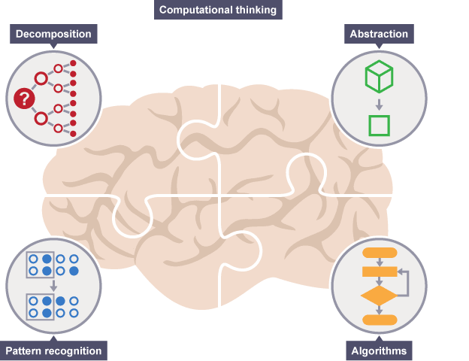
What is Computational Thinking
Notes:
Resources:
https://www.bbc.com/education/guides/zp92mp3/revision/1
https://computationalthinkingcourse.withgoogle.com/unit

Slide 2




Learning Outcomes
Explain what is Computational Thinking
Apply Computational Thinking (CT) to solve problems
Learn 15 mins
Activity 45 mins
Quiz 10 mins
Tea break

Slide 3

What is Computational Thinking?
https://www.youtube.com/watch?v=sxUJKn6TJOI

Slide 4
Computational Thinking Is NOT
Computer literacy, i.e., how to use Spreadsheet, Google, Social Media tools
Computational Thinking Is NOT
Computer programming, i.e., Java Programming, etc.

Slide 5
Computational Thinking provides a set of problem-solving skills.

Slide 6
Benefits of Computational Thinking
Deal with open-ended problems
Have the confidence to deal with complexity
Persevere when faced with challenges
Have the ability to communicate and work with others to achieve a common goal or solution

Slide 7
Source : https://www.bbc.co.uk/education/guides/zp92mp3/revision

Slide 8
Big Complex Problem
Smaller subproblem
Smaller subproblem
Smaller subproblem
Smaller subproblem
Smaller subproblem
Smaller subproblem
Smaller subproblem
Smaller subproblem
Smaller subproblem
Smaller subproblem
Smaller subproblem
Smaller subproblem

Slide 9
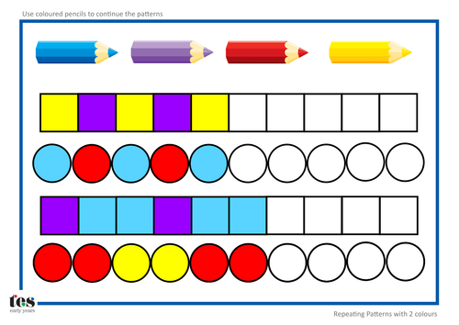
Looking for pattern and trends
https://www.tes.com/teaching-resource/-what-is-computational-thinking-posters-11415759

Slide 10

Removing detail to simplify and focus attention
Credit : Unsplash

Slide 11
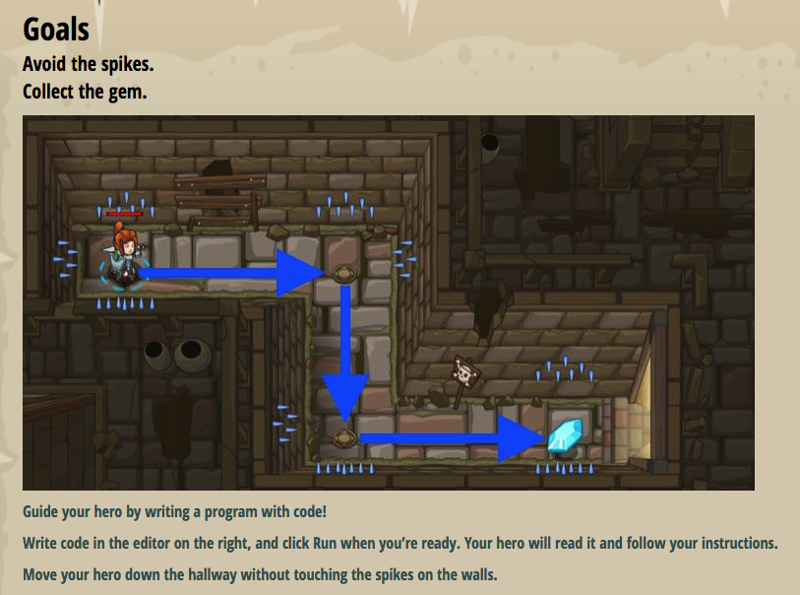
Constructing a sequence of instruction to get things done
Credit : Codecombat

Slide 12
Computational Thinking in daily life
Pipelining (Correct sequence)
Set of data processing elements connected in series, where the output of one element is the input of the next one
E.g. Placing the salad sauce after the salad at a buffet line
Hashing
Storing a list of data items according to their hash values. Hashing is used so that searching can be done more efficiently
E.g. Storing of LEGO blocks according to their size, shape, etc.
Sorting
Arrange a list of data items in a certain order
E.g. Storing of books in alphabetical order (A-Z)

Slide 13
Computational Thinking in other disciplines
Sciences (Biology, Chemistry, Physics)
Medicine
Astronomy
Engineering
Finance
Economics
Healthcare
Journalism
etc…

Slide 14
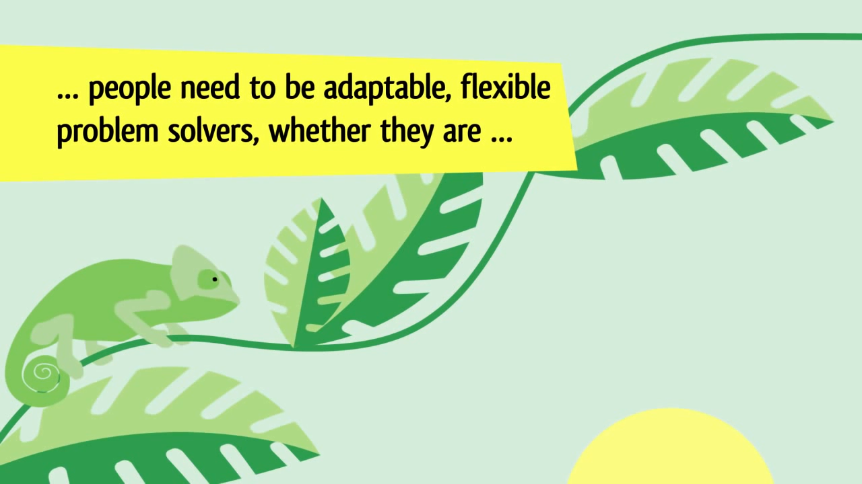
A Digital Age Skill for Everyone
https://www.youtube.com/watch?v=VFcUgSYyRPg

Slide 15


Class
Activity
Task 1 Computational Thinking in Daily Life

Slide 16
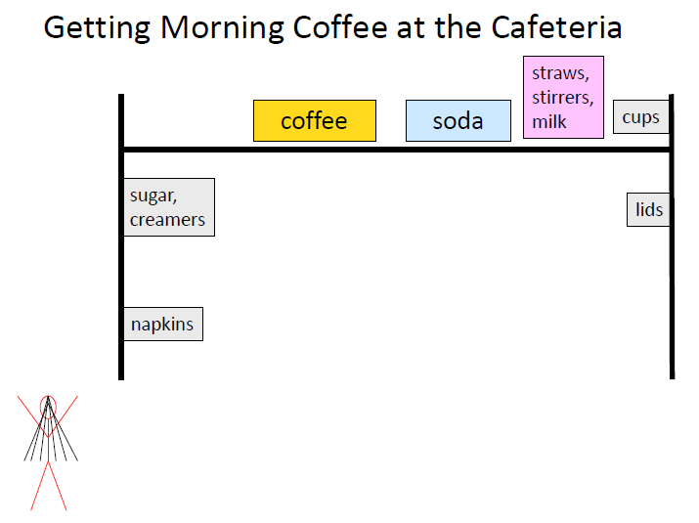
Activity: CT in daily life
What’s wrong with this?

Slide 17
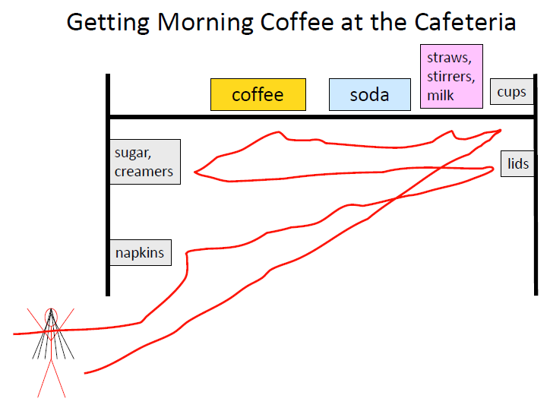
Activity: CT in daily life

Slide 18
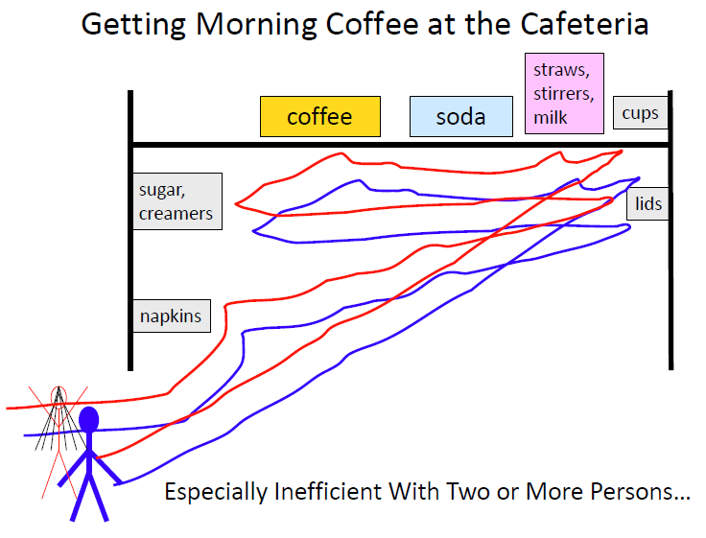
Activity: CT in daily life

Slide 19
Activity: CT in daily life
So what’s the solution?

Slide 20

Activity: CT in daily life
1st consideration – shortest path

Slide 21
Activity: CT in daily life
Anyone can point out anything wrong here?
3
4
5
2
6
1
Sequence ! You cannot get liquid coffee/milk before the Cup

Slide 22
Activity: CT in daily life
Anyone to point out anything irrelevant in this scenario?
Considerations
Shortest path
Sequence
Must get cup before coffee and milk
Soda !

Slide 23
Activity: CT in daily life
Considerations
Shortest path
Sequence
Must get cup before coffee and milk
Exclude unimportant details

Slide 24
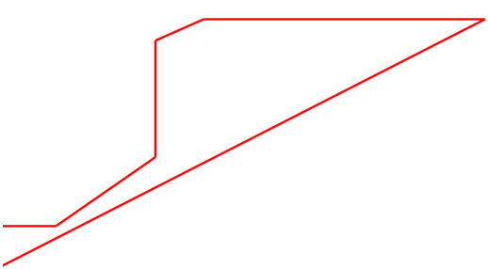
Activity: CT in daily life
So what’s the solution?
4
3
2
5
1
6

Slide 25
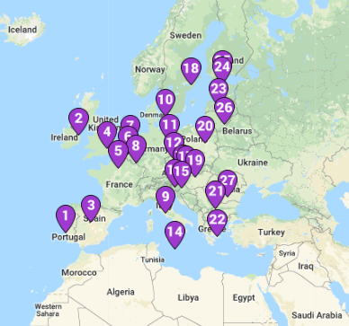
CT in Travel
Prize for student with shortest route
Shortest Route
Notes:
In the drawing below are a set of points. Using a ruler and a pencil, try to draw the shortest route you can that connects all of the points. As you draw each line, keep track of the length of each line so you know how long your route is.

Slide 26
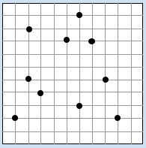
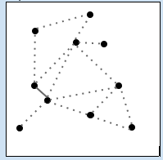
Shortest Path
Notes:
Walk students through the following:
In the drawing below are a set of points. Using a ruler and a pencil, try to draw the shortest route you can that connects all of the points. As you draw each line, keep track of the length of each line so you know how long your route is.

Slide 27
Shortest Path
Notes:
10 nodes so we should have at least have 9 lines
Next, join the shortest lines first

Slide 28
Can we solve this computationally?
Dijkstra’s shortest path Algorithm
https://youtu.be/GazC3A4OQTE
Notes:
Dijkstra's Shortest Path Algorithm - A Detailed and Visual Introduction (freecodecamp.org)

Slide 29
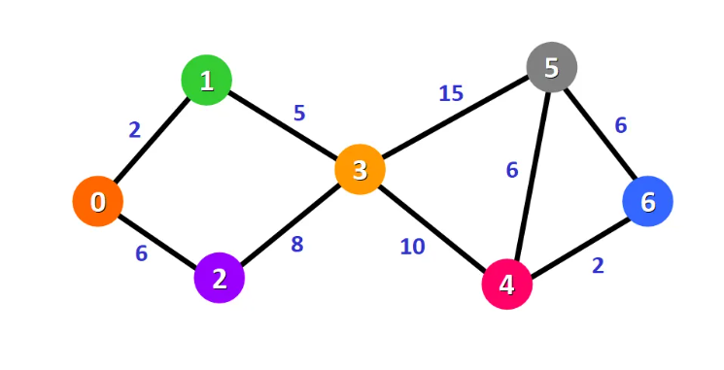
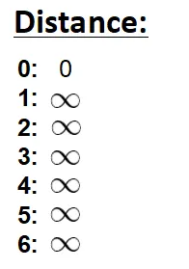
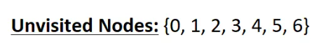
Dijkstra's Algorithm
Notes:
To solve any shortest path with Dijkstra algo, we need to decide for a source point.
We will have the shortest path from node 0 to node 1, from node 0 to node 2, from node 0 to node 3, and so on for every node in the graph.
Initially, we have this list of distances
The distance from the source node to itself is 0. For this example, the source node will be node 0 but it can be any node that you choose.
The distance from the source node to all other nodes has not been determined yet, so we use the infinity symbol to represent this initially.

Slide 30
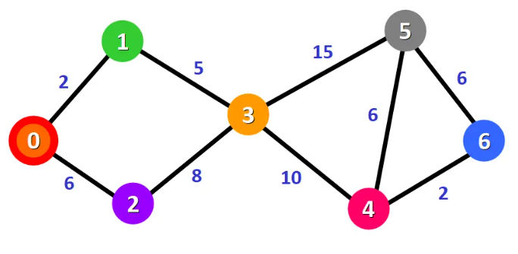
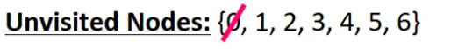
Dijkstra's Algorithm

Slide 31
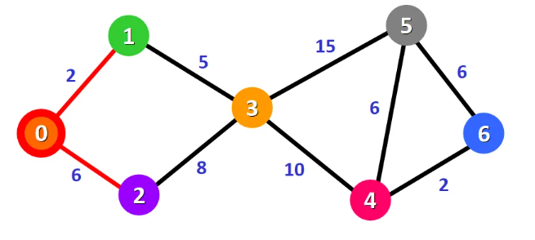
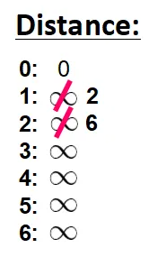
Dijkstra's Algorithm
Notes:
After updating the distances of the adjacent nodes, we need to:
Select the node that is closest to the source node based on the current known distances.
Mark it as visited.
Add it to the path
The weight is 2 and 6

Slide 32
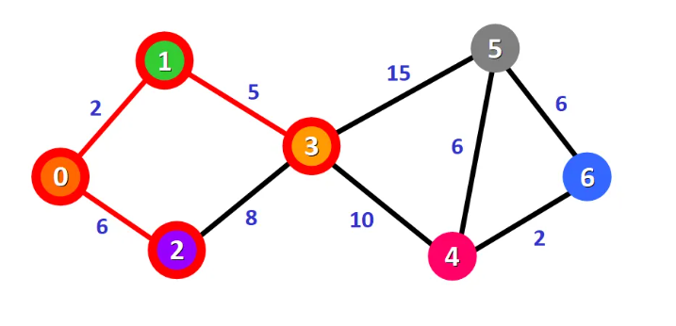
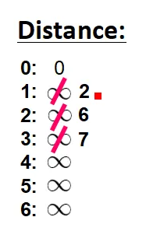

Dijkstra's Algorithm
Notes:
For node 3: the total distance is 7 because we add the weights of the edges that form the path 0 -> 1 -> 3

Slide 33
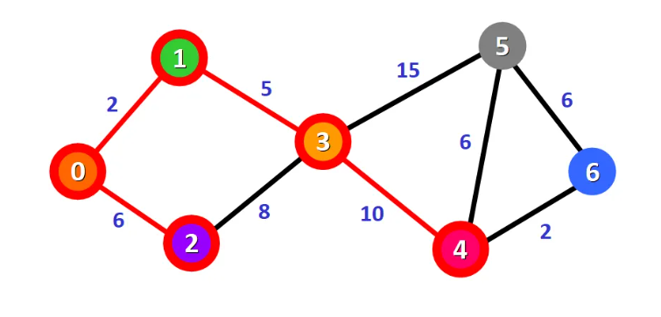
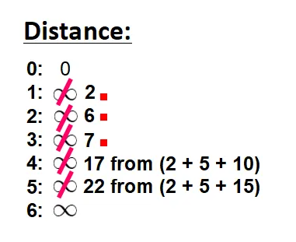
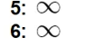

Dijkstra's Algorithm
Notes:
For node 4: the distance is 17 from the path 0 -> 1 -> 3 -> 4.
For node 5: the distance is 22 from the path 0 -> 1 -> 3 -> 5.
Notice that we can only consider extending the shortest path (marked in red). We cannot consider paths that will take us through edges that have not been added to the shortest path (for example, we cannot form a path that goes through the edge 2 -> 3).

Slide 34
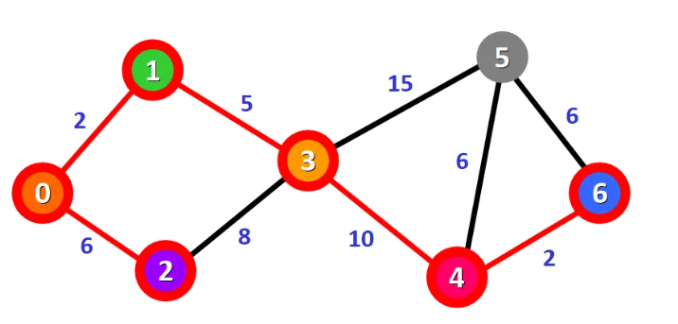
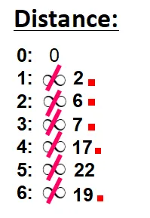
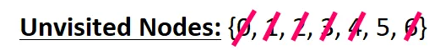
Dijkstra's Algorithm
At node 4, we can find the shortest path to the next node which is point 6 first
Last is to solve the node 5
Notes:
The red square beside my distance numbers just means the point I have visited. So left point 5 which we can either solve with the distance from point 3.
So it is 2+5+15 = 22
Or I can reach from point 4, which is 2+5+10+6= 23

Slide 35
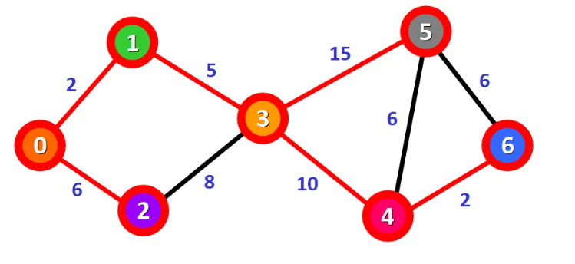
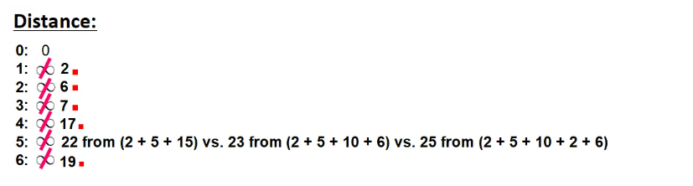
Dijkstra's Algorithm

Slide 36
What is Recursion in Computational Thinking?
Programming Loops vs Recursion - Computerphile (youtube.com)

Slide 37
Activity
Individual
Task 2 Building Towers

Slide 38

CT in Math Puzzle
(Open link in Chrome or
Microsoft Edge)
Hanoi Tower - Apps on Google Play
3 disks - 7 moves
4 disks - 15 moves
5 disks - 31 moves
n disks - 2^{n}-1 moves
64 disks - 2⁶⁴-1 moves
Notes:
Tower Puzzle

Slide 39
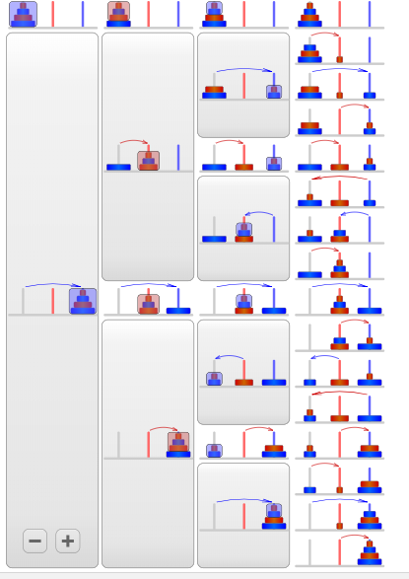
Tower Recursion

Slide 40

Rules of the Game
pattern match between each experience by circling the sections of words that are identical from player to player.
Next, have them abstract away differences from each experience by underlining words that change from player to player.
Using pattern matching and abstraction, have them make a script template for game play by writing up the circled parts of the other students’ experiences, and leaving the underlined sections as blanks. For example:

Slide 41
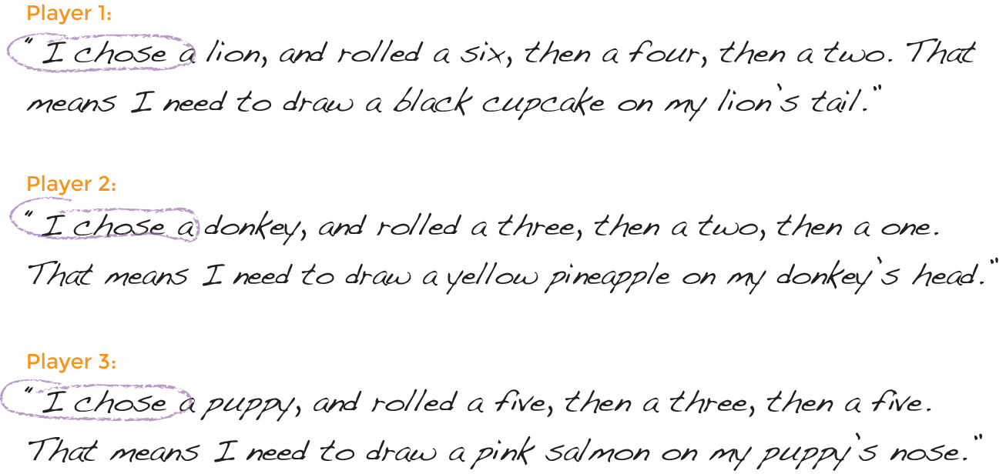
Notes:
I chose a lion and rolled a six, then a four, then a two. That means I need to draw a black cupcake on my Lion’s tail.

Slide 42
While will repeat until condition is not true
wordset1 = string[];
wordset2 = string[];
wordset3 = string[];
Once condition is untrue, stop doing.
While (wordset1.count < 27)
{
}
Is wordset1 same as wordset2 and wordset3?
If same, circle them
If different, underline them

Slide 43

Thank you

